Slide 1
Well-behaved objects
7.0

Slide 2
Main concepts to be covered
Testing
Debugging
Test automation
Writing for maintainability

Slide 3
Code snippet of the day
public void test()
{
int sum = 1;
for (int i = 0; i <= 4; i++);
{
sum = sum + 1;
}
System.out.println("The result is: " + sum);
System.out.println("Double result: " + sum+sum);
}
What is the output?
Notes:
The result is: 2
Double result: 22

Slide 4
Possible results
The result is: 5
Which of these is printed?
The result is: 6
The result is: 11
The result is: 2
Double result: 22
The result is: 2
Double result: 12
Double result: 4
Double result: 22
Double result: 66

Slide 5
Code snippet of the day
public void test()
{
int sum = 1;
for (int i = 0; i <= 4; i++);
{
sum = sum + 1;
}
System.out.println("The result is: " + sum);
System.out.println("Double result: " + sum+sum);
}
Notes:
The result is: 2
Double result: 22

Slide 6
We have to deal with errors
Early errors are usually syntax errors.
The compiler will spot these.
Later errors are usually logic errors.
The compiler cannot help with these.
Also known as bugs.
Some logical errors have no immediately obvious manifestation.
Commercial software is rarely error free.

Slide 7
Prevention vs Detection (Developer vs Maintainer)
We can lessen the likelihood of errors:
Use software engineering techniques, like encapsulation.
Pay attention to cohesion and coupling.
We can improve the chances of detection:
Use software engineering practices, like modularization and good documentation.
We can develop detection skills.

Slide 8
Testing and debugging
These are crucial skills.
Testing searches for the presence of errors.
Debugging searches for the source of errors.
The manifestation of an error may well occur some 'distance' from its source.

Slide 9
Testing and debugging techniques
Unit testing (within BlueJ)
Test automation
Manual walkthroughs
Print statements
Debuggers

Slide 10
Unit testing
Each unit of an application may be tested.
Method, class, module (package in Java).
Can (should) be done during development.
Finding and fixing early lowers development costs (e.g. programmer time).
A test suite is built up.

Slide 11
Testing fundamentals
Understand what the unit should do – its contract.
You will be looking for violations.
Use positive tests and negative tests.
Test boundaries.
Zero, One, Full.
Search an empty collection.
Add to a full collection.
Search for/remove the only element.

Slide 12
Well-behaved objects
Test automation

Slide 13
Main concepts to be covered
Unit testing
JUnit
Regression testing
Test cases
Test classes
Assertions
Fixtures

Slide 14
Unit testing within BlueJ
Objects of individual classes can be created.
Individual methods can be invoked.
Inspectors provide an up-to-date view of an object's state.
Explore through the online-shop project.

Slide 15
Demo of online-shop

Slide 16
Test automation
Good testing is a creative process, but ...
... thorough testing is time consuming and repetitive.
Regression testing involves re-running tests.
Use of a test rig or test harness can relieve some of the burden.

Slide 17
Test harness
Additional test classes are written to automate the testing.
Objects of the harness classes replace human interactivity.
Creativity and imagination required to create these test classes.
Test classes must be kept up to date as functionality is added.

Slide 18
Test automation
Test frameworks exist to support automation.
Explore fuller automation through the online-shop-junit project.
Intervention only required if a failure is reported.

Slide 19
Demo of online-shop-junit

Slide 20
JUnit
JUnit is a Java test framework
Test cases are methods that contain tests
Test classes contain test methods
Assertions are used to assert expected method results
Fixtures are used to support multiple tests

Slide 21
Well-behaved objects
Debugging

Slide 22
Prevention vs Detection (Reprise)
We can lessen the likelihood of errors:
Use software engineering techniques, like encapsulation.
Pay attention to cohesion and coupling.
We can improve the chances of detection:
Use software engineering practices, like modularization and good documentation.
We can develop detection skills.

Slide 23
Debugging techniques
Manual walkthroughs
Print statements
Debuggers

Slide 24
Modularization and interfaces
Applications often consist of different modules:
E.g. so that different teams can work on them.
The interface between modules must be clearly specified.
Supports independent concurrent development.
Increases the likelihood of successful integration.

Slide 25
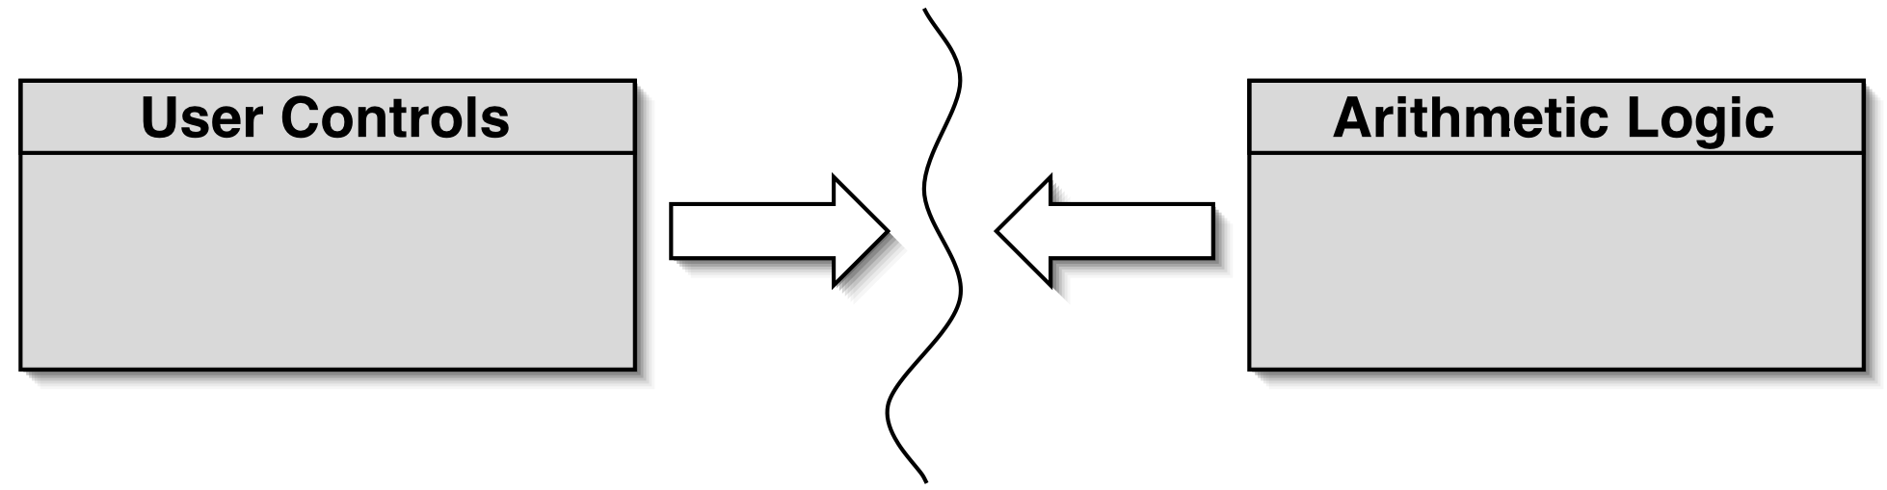
Modularization in a calculator
Each module does not need to know implementation details of the other.
User controls could be a GUI or a hardware device.
Logic could be hardware or software.

Slide 26
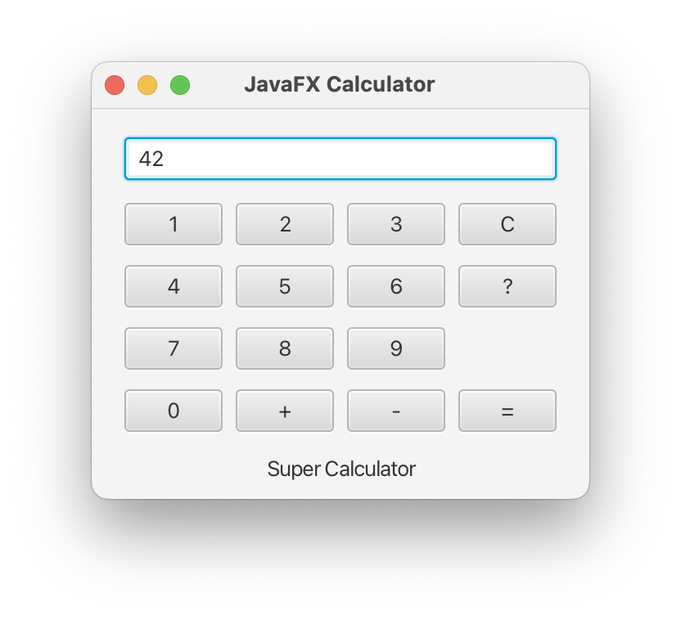
Method headers as an interface
// Return the value to be displayed.
public int getDisplayValue();
// Call when a digit button is pressed.
public void numberPressed(int number);
// Plus operator is pressed.
public void plus();
// Minus operator is pressed.
public void minus();
// Call to complete a calculation.
public void equals();
// Call to reset the calculator.
public void clear();

Slide 27
Debugging
It is important to develop code-reading skills.
Debugging will often be performed on others' code.
Techniques and tools exist to support the debugging process.
Explore through the calculator-engine project.

Slide 28
Manual walkthroughs
Relatively underused.
A low-tech approach.
More powerful than appreciated.
Get away from the computer!
'Run' a program by hand.
High-level (Step) or low-level (Step into) views.

Slide 29
Tabulating object state
An object's behavior is largely determined by its state …
… so incorrect behavior is often the result of incorrect state.
Tabulate the values of key fields.
Document state changes after each method call.

Slide 30
Verbal walkthroughs
Explain to someone else what the code is doing:
They might spot the error.
You might spot the error, through the process of explaining.
Group-based processes exist for conducting formal walkthroughs or inspections.

Slide 31
Print statements
The most popular technique.
No special tools required.
All programming languages support them.
Only effective if the right methods are documented.
Output may be voluminous!
Turning off and on requires forethought.

Slide 32
Choosing a test strategy
Be aware of the available strategies.
Choose strategies appropriate to the point of development.
Automate whenever possible.
Reduces tedium.
Reduces human error.
Makes (re)testing more likely.

Slide 33
Debuggers
Debuggers are both language- and environment-specific.
BlueJ has an integrated debugger.
Support breakpoints.
Step and Step-into controlled execution.
Call sequence (stack).
Object state.

Slide 34
Debugging streams
A pipeline of multiple operations might be hard to debug.
The peek operation can provide insights.
Consumer that passes on its input unchanged; e.g.: peek(s -> System.out.println(s))

Slide 35
Review
Errors are a fact of life in programs.
Good software development techniques can reduce their occurrence.
Testing and debugging skills are essential.
Make testing a habit.
Automate testing where possible.
Continually repeat tests.
Practice a range of debugging skills.

